Slide 1










ATS
IT
Trends
HTML
Presented by Tú and Vỹ
Feedback
Ads

Slide 2






TABLE OF CONTENTS
INTRODUCE
HTML BASIC
HTML ELEMENT
HTML ATTRIBUTE
HTML FORM

Slide 3






Potential
Market
WHAT IS HTML?
Introduce
HTML is the standard markup language for creating Web pages
HTML describes the structure of a Web page
HTML consists of a series of elements
HTML elements tell the browser how to display the content
Available
Market

Slide 4
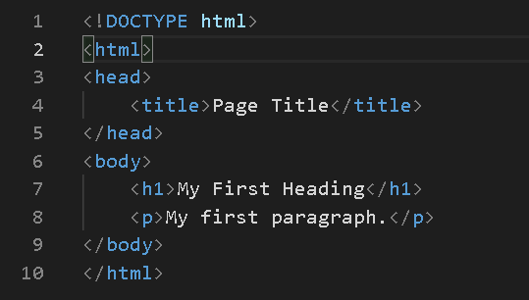
Potential
Market
STRUCTURE
HTML BASIC
Available
Market

Slide 5
HTML ELEMENTS
TEXT FORMATTING
LINK ELEMENTS
IMAGE ELEMENTS
LIST ELEMENTS
TABLE ELEMENTS

Slide 6

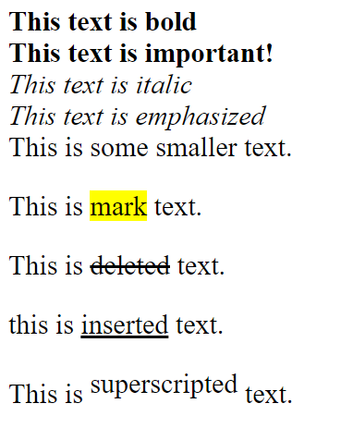


HTML FORMATTING ELEMENTS
<b> - Bold text
<strong> - Important text
<i> - Italic text
<em> - Emphasized text
<mark> - Marked text
<small> - Smaller text
<del> - Deleted text
<ins> - Inserted text
<sub> - Subscript text
<sup> - Superscript text

Slide 7
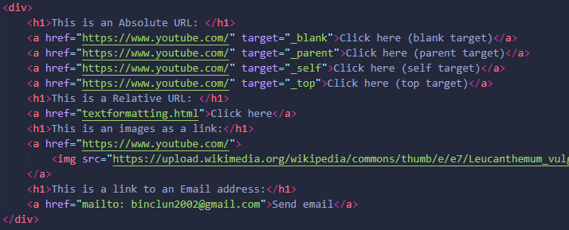
LINK ELEMENTS
- <a> element: to define a link
- href attribute to define the link - address (absolute & relative)
- target attribute to define where to open the linked document:
_self (default): Opens the document in the same window/tab as it was clicked
_blank - Opens the document in a new window or tab
- <img> element (inside <a>) to use an image as a link
- mailto: scheme inside the href attribute to create a link that opens the user's email program

Slide 8


IMAGE ELEMENTS
Example:

Slide 9
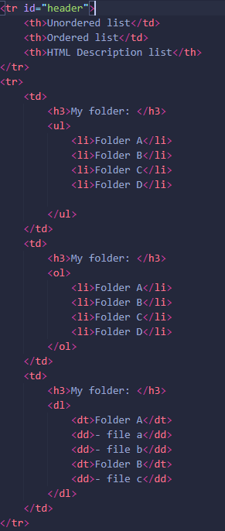
LIST ELEMENTS
There are an unordered list, an ordered list, HTML description list
Each list has:
<ul> Defines an unordered list
<ol> Defines an ordered list
<li> Defines a list item
<dl> Defines a description list
<dt> Defines a term in a description list
<dd> Describes the term in a description list

Slide 10
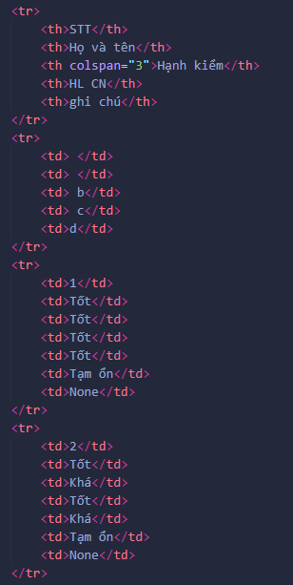
TABLE ELEMENTS
<table> Defines a table
<th> Defines a header cell in a table
<tr> Defines a row in a table
<td> Defines a cell in a table
<caption> Defines a table caption
<colgroup> Specifies a group of one or more columns in a table for formatting
<col> Specifies column properties for each column within a <colgroup> element
<thead> Groups the header content in a table
<tbody> Groups the body content in a table
<tfoot> Groups the footer content in a table

Slide 11
HTML ATTRIBUTES
ATTRIBUTE SYNTAX
COMMON ATTRIBUTES

Slide 12

ATTRIBUTE SYNTAX
examples:
<a href="https://www.youtube.com">YOUTUBE</a>

Slide 13
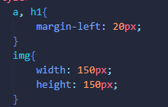
COMMON ATTRIBUTES
href of <a>
src of <img>
width and height of <img>
alt of <img>
style
lang of <html>
title

Slide 14
HTML FORM
HTML FORM ATTRIBUTES
HTML FORM ELEMENTS
HTML INPUT TYPES
HTML INPUT ATTRIBUTES
HTML INPUT FORM ATTRIBUTE

Slide 15
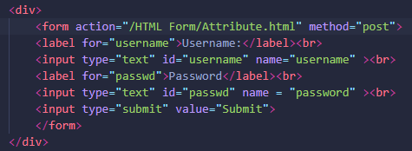
HTML FORM ATTRIBUTES
The action attribute defines the action to be performed when the form is submitted.
The method attribute specifies the HTTP method to be used when submitting the form data.
Tip: Always use POST if the form data contains sensitive or personal information!

Slide 16
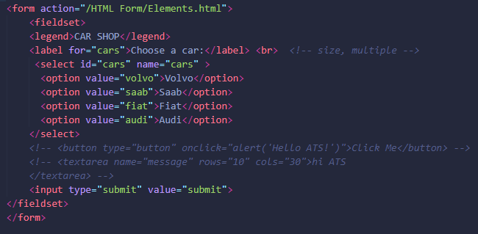
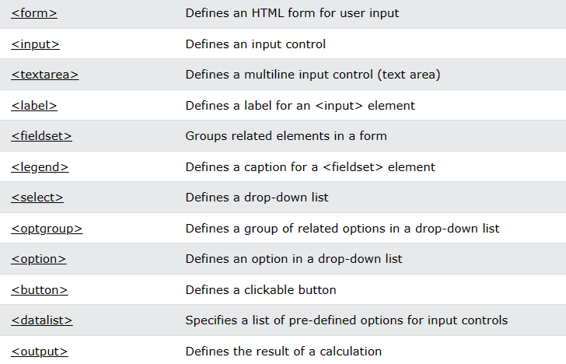
HTML FORM ELEMENTS

Slide 17
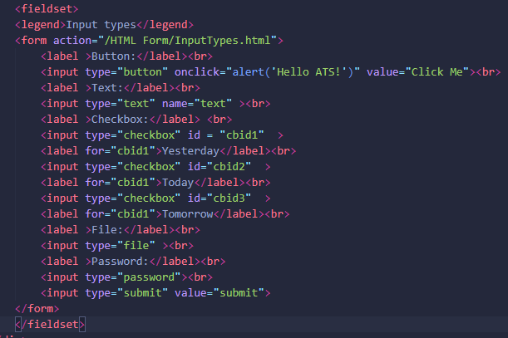
HTML INPUT TYPES
There are many html input types, such as:
<input type="button">
<input type="text">
<input type="checkbox">
<input type="file">
<input type="password">
<input type="submit">
...
ref: HTML Input Types (w3schools.com)

Slide 18

HTML INPUT ATTRIBUTES
Some Input attributes:
The Value attribute
The readonly attribute
The disabled attribute
The size attribute
The placeholder attribute
...
ref: HTML Input Attributes (w3schools.com)

Slide 19

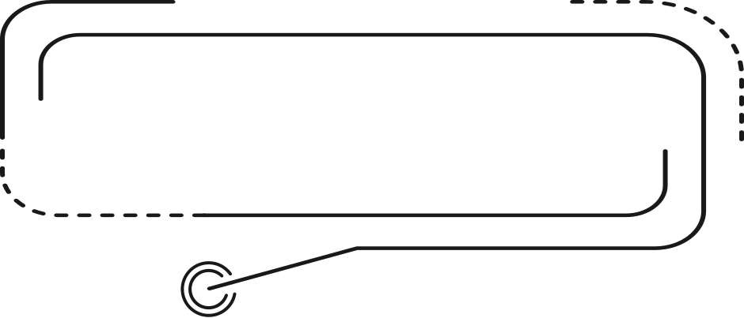

HTML BASIC
THANK YOU
THANKS EVERYONE FOR JOINING THIS SEMINAR

